Slide 1

Migration and Availability Solutions for Windows and Linux
Andy Ebbs
Solution Architect UK and Ireland
andy.ebbs@visionsolutions.com

Slide 2


Slide 3


Slide 4
Replicate anything to anything
(hardware, application, hypervisor independent)

Slide 5
Replicate anywhere to anywhere
(unlimited distance, very low bandwidth consumption)

Slide 6



SOURCE
TARGET
Physical
To anywhere
Physical
To anywhere
Virtual
How you want it
Virtual
How you want it
Cloud
Storage agnostic
Cloud
Storage agnostic

Slide 7
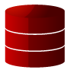
How does replication work?
Application Layer
Operating System
Hardware Layer
Application Layer
Operating System
Hardware Layer
User application
Double-Take service
Double-Take service
Double-Take
driver
Double-Take
driver
An initial mirror copies all of the data to the target
HDD
HDD

Slide 8
How does replication work?
Application Layer
Operating System
Hardware Layer
Application Layer
Operating System
Hardware Layer
User application
Double-Take service
Double-Take service
Double-Take
driver
Double-Take
driver
The Double-Take driver sees bytes of I/O en route to the file system and copies them into memory
As confirmation of the write travels back to the application, Double-Take then sends the bytes to the target
HDD
HDD
✓

Slide 9
How does replication work?
Application Layer
Operating System
Hardware Layer
Application Layer
Operating System
Hardware Layer
User application
Double-Take service
Double-Take service
Double-Take
driver
Double-Take
driver
During high-latency periods, Double-Take will buffer changes to memory
If configurable memory buffers are exceeded, Double-Take will buffer to disk for additional latency tolerance
Disk Queue
HDD
HDD

Slide 10
How does replication work?
Application Layer
Operating System
Hardware Layer
Application Layer
Operating System
Hardware Layer
User application
Double-Take service
Double-Take service
Double-Take
driver
Double-Take
driver
Once latency improves, replication resumes transmission, while always preserving write-order integrity
Disk Queue
HDD
HDD

Slide 11
Replication Summary
STAR Technology (Sequential Transfer Asynchronous Replication)
Granular selection of data (file/folder/partition)
Byte-level replication
No distance limitations
Minimum performance loss on the source server
Live filesystem on target server
Three levels of intelligent data compression
Scheduled throttling
256bit AES encryption

Slide 12




One-to-One
One-to-Many
V2V
Single Server
Many-to-One
Full Server to Virtual

Slide 13




Full Server Protection or Migration
AnySource
AnyTarget
AnySource
Reboots and becomes identical to source server
Production Server
Basic Windows file server
Staged information overwrites system configuration (non-hardware)
Staging Directory
System State Data
All Data Files

Slide 14



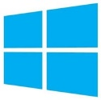
Full Server to Hyper-V migration
Source
Replication
Hyper-V target
Mirror
Mount VHD or VHDX
C: volume (Operating system and applications)
Automatically provision VM
E:
E:
F:
F:
G:
G:
Data volumes (User and application data)
VHDs mounted to VM

Slide 15


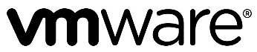

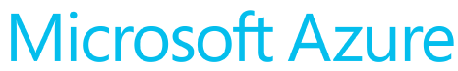
Migration steps
Deploy and connect proxy
Add Azure subscription
Discover source VMs
Create migration job
Finalize migration
Login to CMC
Site-to-site VPN
Customer’s subscription
Virtual network
CMC
Device with modern web browser
CMC proxy

Slide 16
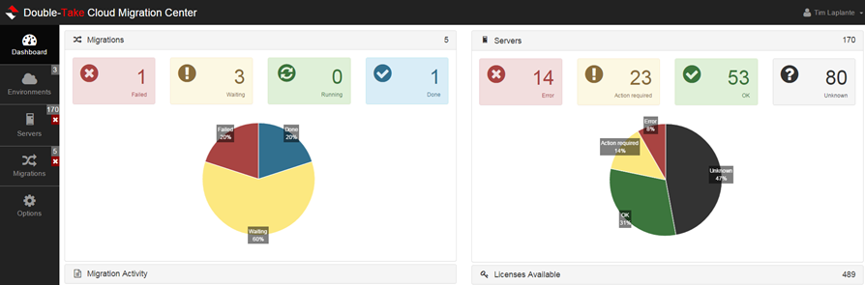

Reduce migration steps
Login
Discover
Migrate
Discover eligible servers
Create target service
Create target instance
Provision target instance
Create install points
Copy Double-Take to source
Install Double-Take on source
Enable Double-Take for source
Enable Double-Take for target
Activate Double-Take license
Create migration
Synchronize
Waiting to cutover
Perform cutover
Activate Windows on target
Complete migration
AUTOMATED
Notes:
This is a list of the steps to complete a migration using Double-Take Move.
On their own, they are not complex, but they can be time consuming.
Double-Take Cloud Migration Center automates these migration steps.
This solution is all automated at a low cost.

Slide 17




1
2
3
Discover
SQL Server workloads
to upgrade/migrate
Target
Only SQL
Databases and
Metadata that
are needed
Upgrade/Migrate
Using a focused inexpensive solution
that puts you
in control
Notes:
Visit http://www.Microsoft.com/SQLServerUpgrade/ to find the tools and resources you need to get started today.
(Can swap in your upgrade process.)

Slide 18
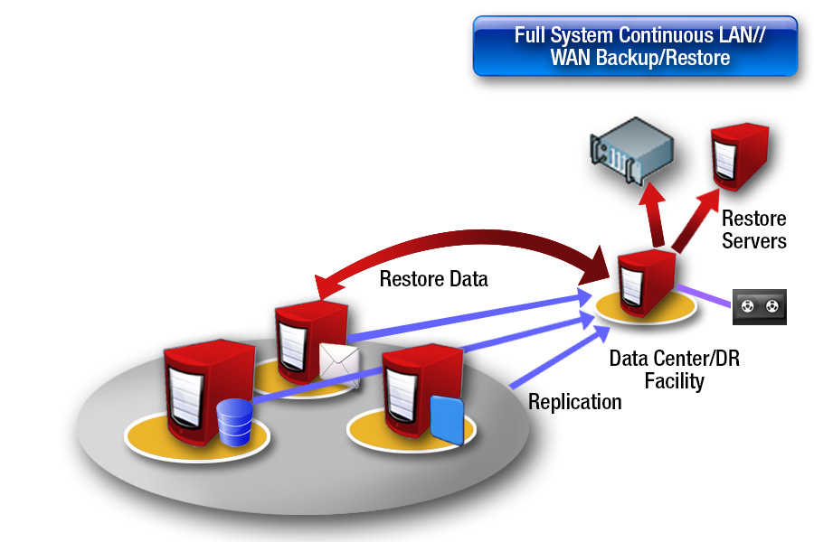


Slide 19
